Slide 1

Sets

Slide 2
Definition
A Python set is the collection of the unordered items. Each element in the set must be unique,
And the sets remove the duplicate elements. Sets are mutable which means we can modify it after its creation.
Unlike other collections in Python, there is no index attached to the elements of the set, i.e., we cannot directly access any element of the set by the index.

Slide 3
Creating the set
Days = {"Monday", "Tuesday", "Wednesday", "Thursday", "Friday", "Saturday", "Sunday"}
print(Days)

Slide 4
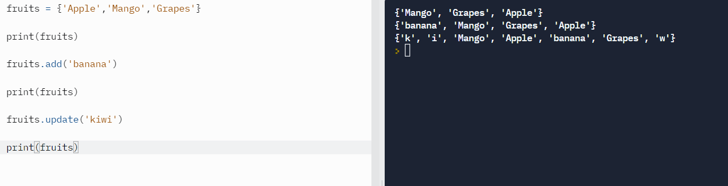
Adding the element

Slide 5
Remove
Python provides the discard() method and remove() method which can be used to remove the items from the set.
The difference between these function, using discard() function if the item does not exist in the set then the set remain unchanged whereas remove() method will through an error.

Slide 6
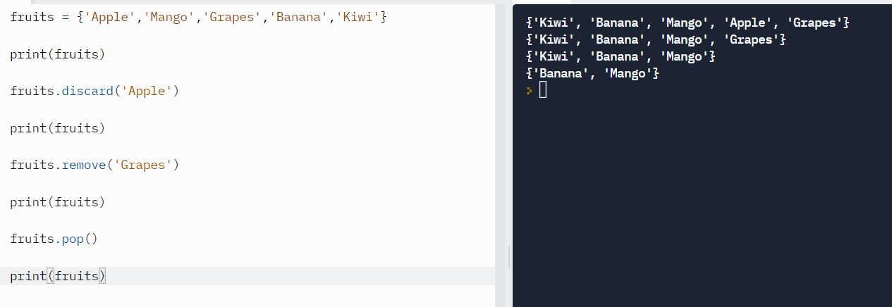

Slide 7
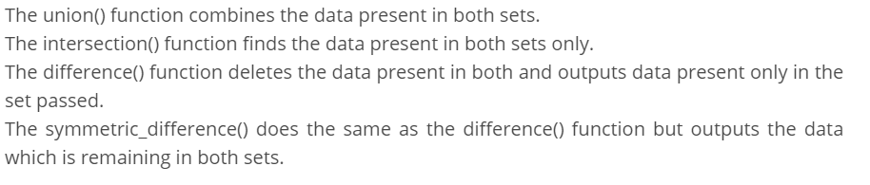
Operators

Slide 8
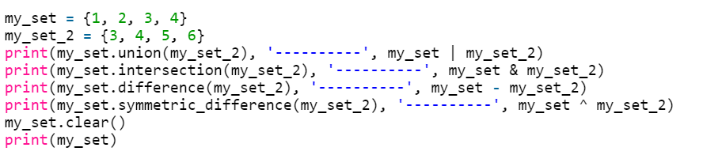
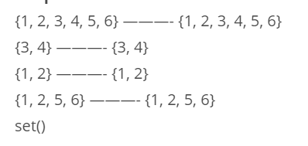
Operations

Slide 9
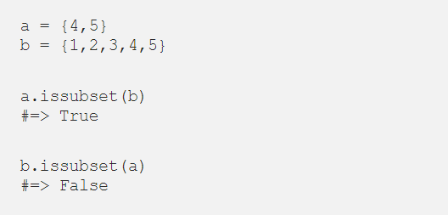
Check is subset

Slide 10
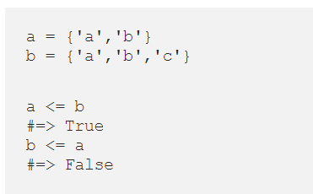
Check if a set is a subset, using comparison operators

Slide 11
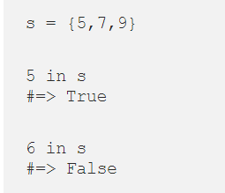
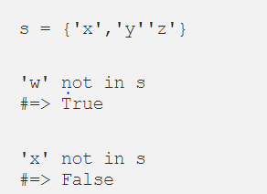
In and not in

